Slide 1
Innovation Project
By: The Treasure Troopers

Slide 2
Problem Identification
Goal of this slide is to describe the Problem very clearly in few sentences
Don’t add too much text
Because of climate change villages and settlements close to the shore have gone underwater. In order to excavate these settlements and villages we have to excavate underwater. Excavating underwater has various challenges and is high cost.
harsh
DDT
Points that we have to cover while speaking
Villages and settlements gone underwater : climate change
Excavating hard ; high cost
Every year the water level rises more and more so villages and settlements go underwater alot.

Slide 3
What I should say while talking
As sea levels rise due to climate change, coastal villages and settlements are increasingly becoming submerged. This requires underwater excavation to study and preserve these submerged cultural heritage sites. However, underwater excavation presents significant challenges, including, the cost of specialized equipment requirements, and the inherently high costs associated with such operations.
Notes:
As sea levels rise due to climate change, coastal villages and settlements are increasingly becoming submerged. This necessitates underwater excavation to study and preserve these submerged cultural heritage sites. However, underwater excavation presents significant challenges, including logistical complexities, specialized equipment requirements, and the inherently high costs associated with such operations.

Slide 4
Why is this problem important and why would it matter if we did or didn't do underwater archeology
Exceptional Preservation: Underwater environments, particularly those with low oxygen levels and cold temperatures, limit the activity of bacteria and physical erosion that would otherwise break down organic materials and structures.
Historical Insights: Studying submerged sites provides unique information about past civilizations, trade, migration, and even climate change that cannot be gleaned from terrestrial sites.
The Artifact: Among the cargo of a Roman-era ship that sank around 60 BCE, Greek sponge divers discovered a lump of corroded bronze. This artifact was later identified as the Antikythera Mechanism, a highly sophisticated analog computer with a complex set of interlocking gears.
The Technology: The mechanism was designed to calculate and display astronomical information, such as the positions of the sun and moon, lunar phases, and eclipses. It was able to track the Metonic cycle, the Saros eclipse cycle, and even the four-year cycle of the Panhellenic Games, including the Olympics.
The Insight: The device revealed a level of mechanical and astronomical knowledge previously thought to have been achieved over a thousand years later, challenging long-held assumptions about ancient technology. Without the underwater preservation, such a fragile and intricate artifact would have disintegrated, and we would never have known of its existence or the advanced engineering behind it.

Slide 5
Why is this problem important and why would it matter if we did or didn't do underwater archeology- script
The unique conditions at the bottom of the ocean, lakes, and bogs—specifically low oxygen levels, cool temperatures, and burial in sediment that create an no oxygen environment that prevents decay. The absence of oxygen and light stops the bacterial activity and physical erosion that breaks down organic materials on land. So without these activities artifacts will be in better condition than on land so we can learn more about that site or artifact. Submerged sites function as time capsules, capturing a specific moment in history and revealing details about past civilizations, migration, trade, and even climate change. The Antikythera shipwreck is a prime example of why underwater archaeology is special and important, showing how marine preservation provides unique historical insights that are impossible to learn from land sites. The shipwreck's was full of cargo and by looking at the cargo we can tell what objects were used in daily life trade and ancient technology.
Things to say
Why is it important
What would we find underwater that can't be found on land?
Give example on why it’s important. (shipwreck)

Slide 6
Our Solution
Our solution is to use the diving bell and make it more effective and affordable by adding a robot so that we can reduce money by size and safety issues . And we don't need to pump in oxygen.because it is a robot we could just drop a concrete box sort of and it will hold the air inside. We got this idea from a TV show that we were watching. We also tested this out and it seemed to work.now you might be wondering how do we got this down there first of all well we could use a crane / scissor arm.
We decided to put an AI bot inside because:
Our solution is to use the diving bell but make it more low cost by
It could be working longer than we can work
Does not need to sleep
Does not need to eat lunch breakfast lunch and dinner
Don't need to make another room for people to get in and out.
Reduces cost
Can excavate faster
-reducing size,
-replacing the people with robots
-removing pipes because you don't have to pump in oxygen
- doesn't need to be as safe as it would be if your sending in people

Slide 7
Now on to Nihira’s slides

Slide 8
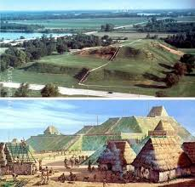
WARNING! FACTS INCOMING!!
Well, we are learning about the city of Cahokia. So let’s go “sea the seas!”
Cahokia was a big, advanced, ancient city, north of Mexico. But this is the most devastating question, why is Cahokia a “Lost city?”
The answer to that is that 250 years later, Cahokia was abandoned, the grass on its 120 earthen mounds grew tall and was not tended. Researches feel that the inhabitants used up all the area’s natural resources and over hunted and deforested the entire land surrounding the major city.

Slide 9
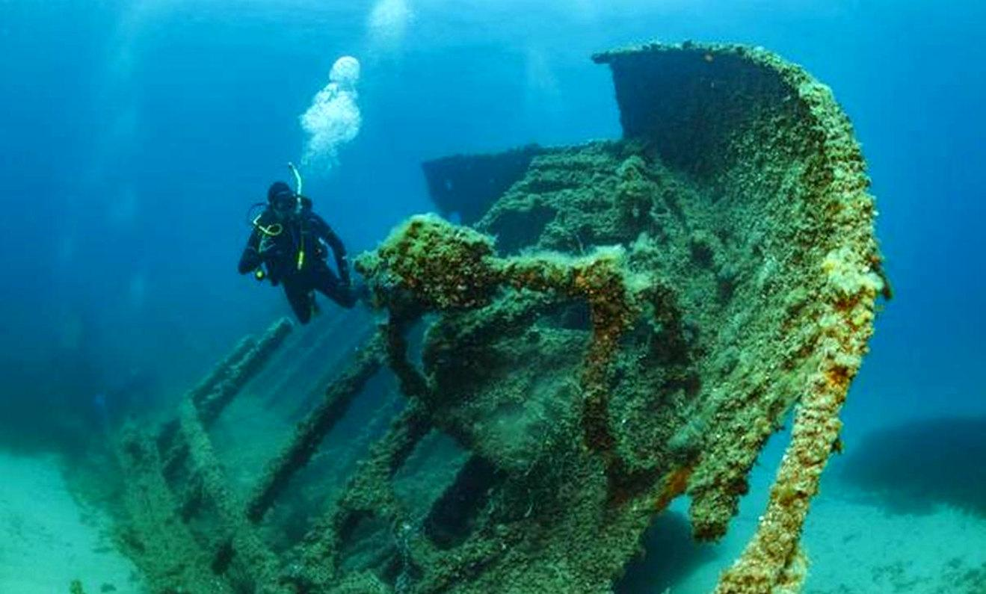
Want to know about another underwater city?
Dwarka – (estimated range from 3,000 to 9,000 years old)
Off the coast of Gujarat, India, near modern-day Dwarka Linked to the ancient city described in Hindu epics (Mahabharata) Believed to be Lord Krishna’s birthplace
Underwater Discoveries
Marine explorations by the National Institute of Oceanography (NIO) Submerged structures: stone walls, statues, pillars, and grids
Archaeological Significance
Ancient urban planning Early maritime trade and civilization
Would you like a second slide that goes deeper into the scientific methods used in exploring Dwarka or the debates between mainstream and alternative archaeologists?

Slide 10
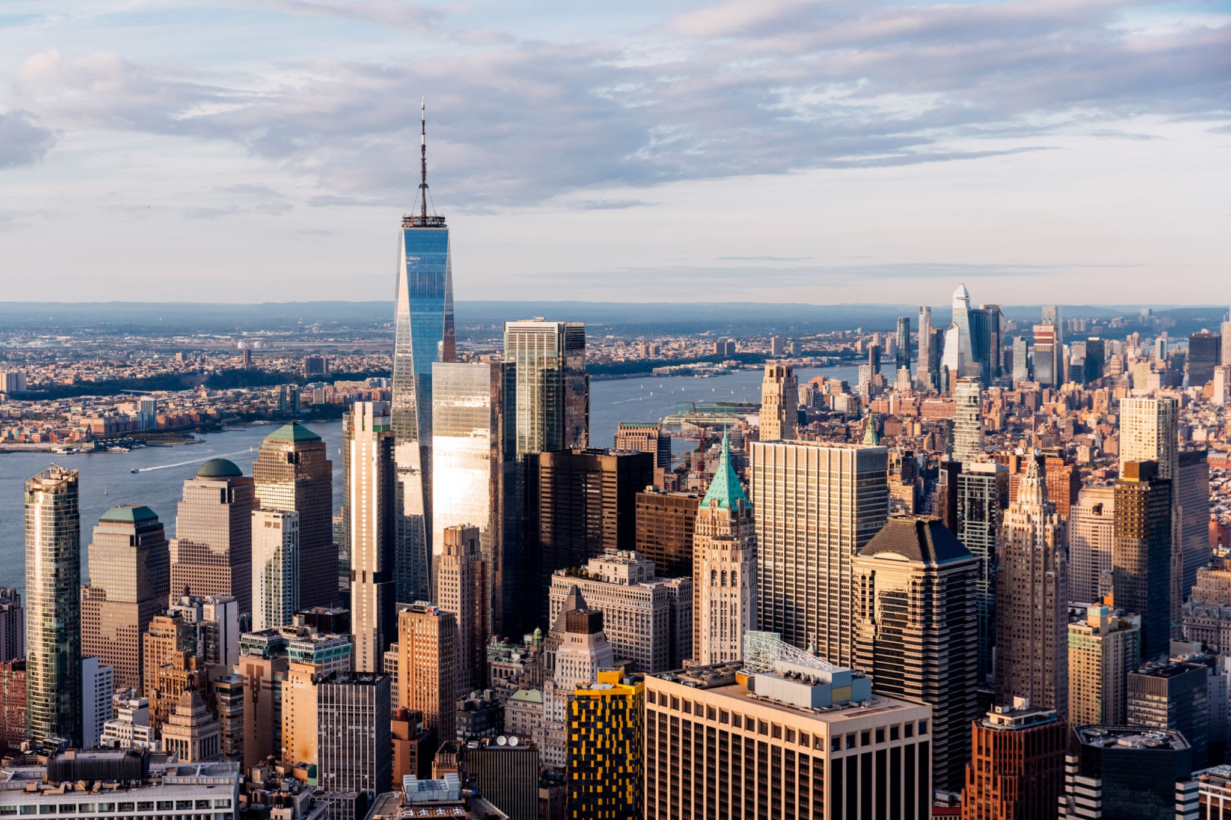
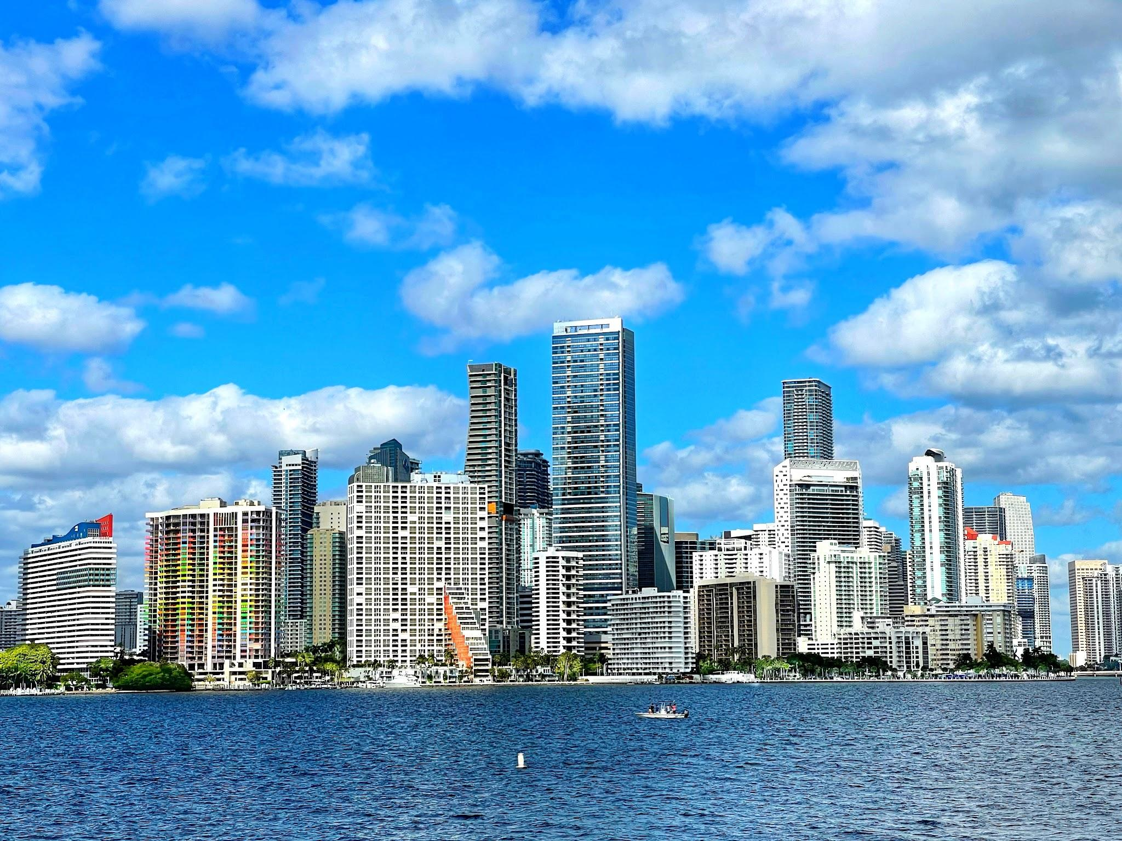
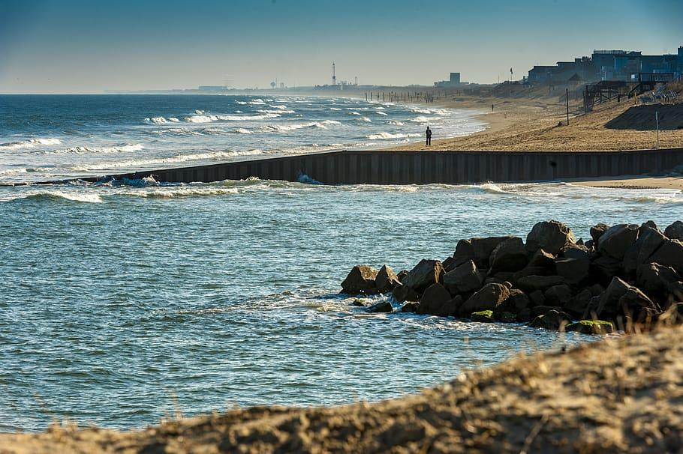
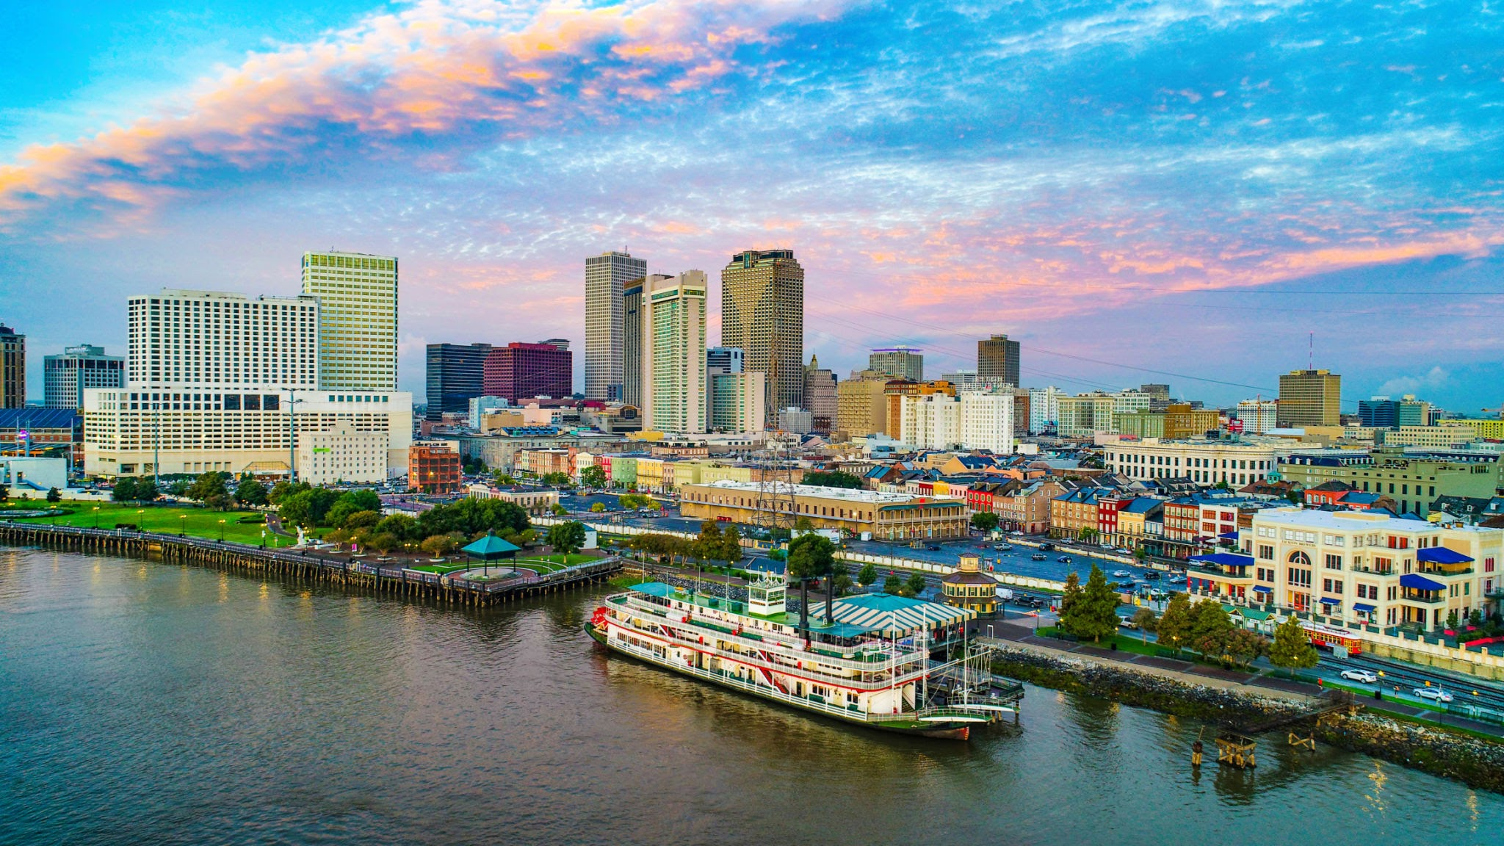
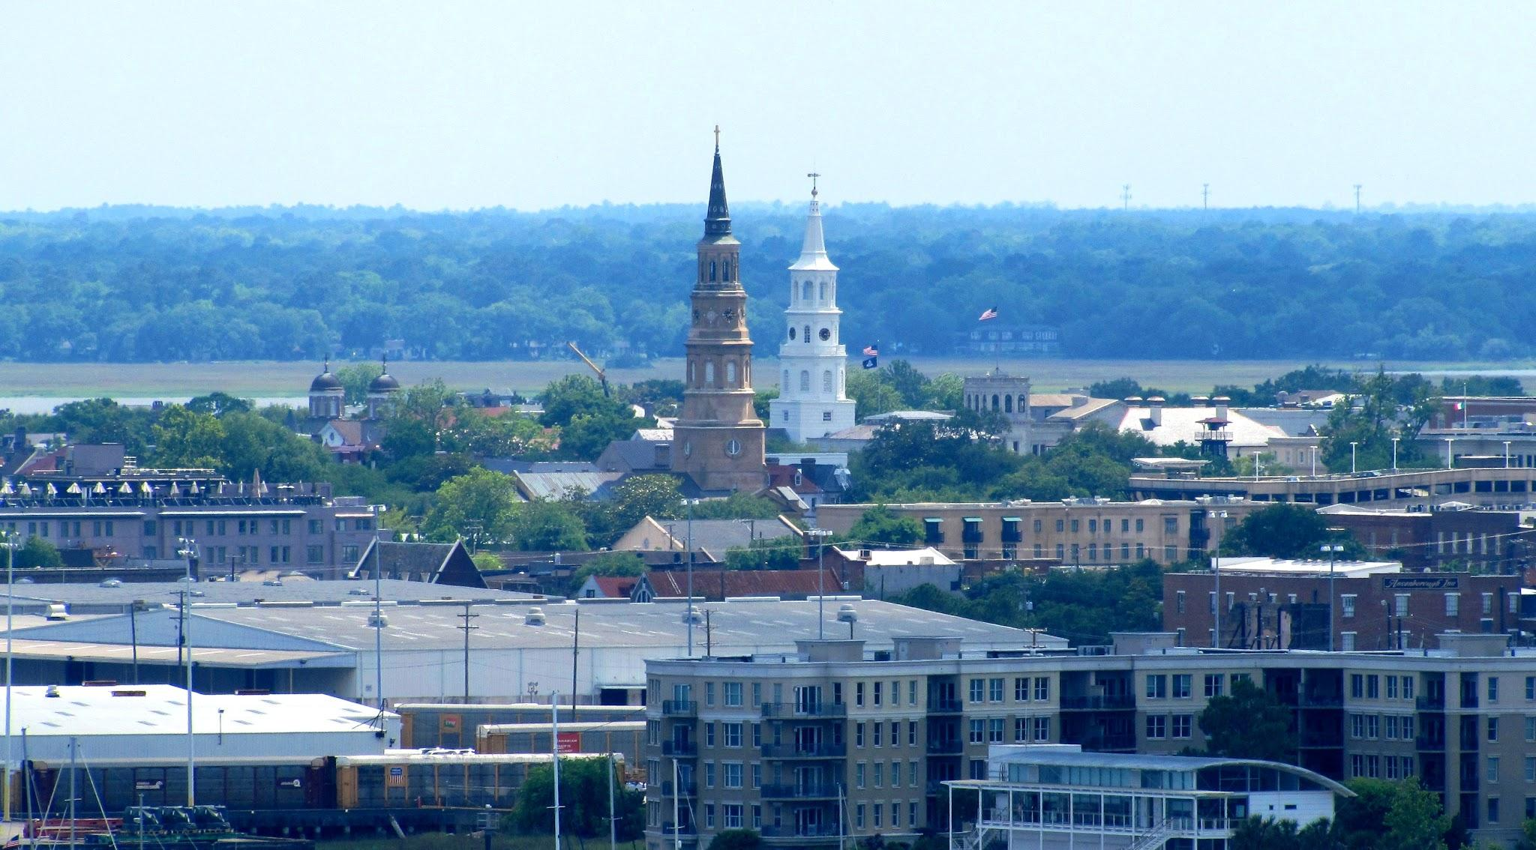
Existing PROBLEMS
Did you know that there are some cities ABOUT TO BE AT RISK?
And they are sadly, in the U.S.A. Some cities are: New Orleans, Louisiana, Miami Florida, Virginia Beach, Virginia, Charleston, South Carolina, and New York City.
New York City
New Orleans
Virginia Beach
Charleston
Miami

Slide 11
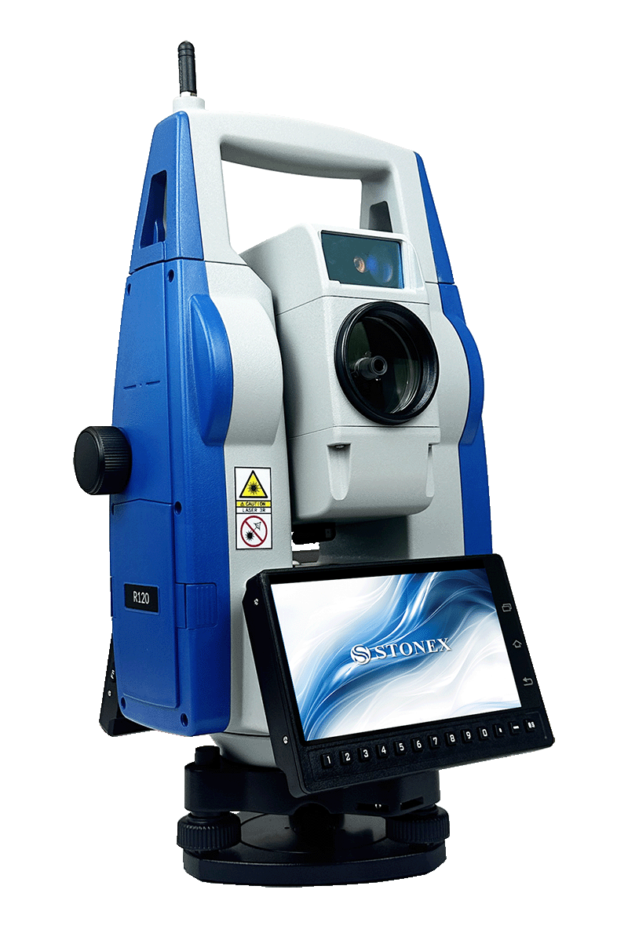
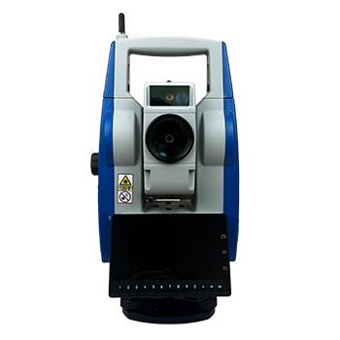
Existing Solutions
UNDERWATER CITIES
Examples of underwater cities are Pavlopetri, Greece, Derwent, UK, Baiae, Port Royal, and Shi Cheng.
In Pavlopetri archaeologists used a Robotic Total Station: A land based instrument used to find the exact location of divers holding a prism- equipped pole over the site. It is a tool used to survey the land.
AUV (Autonomous Underwater Vehicle): A quicker technique and also made to collect pictures.
Notes:
AUVs carry a variety of equipment for sampling and surveying such as cameras, sonar, and depth sensors. AUV stores all data, including images and other sensor data, on onboard computers until it can be retrieved after the AUV is recovered at the end of a dive.
AUVs are safe from bad weather and can stay underwater for extended periods of time. Scientists use AUVs to create maps of the ocean floor, record environmental information, sense what humans have left behind, identify hazards to navigation, explore geologic formations, document shipwrecks, and more.

Slide 12
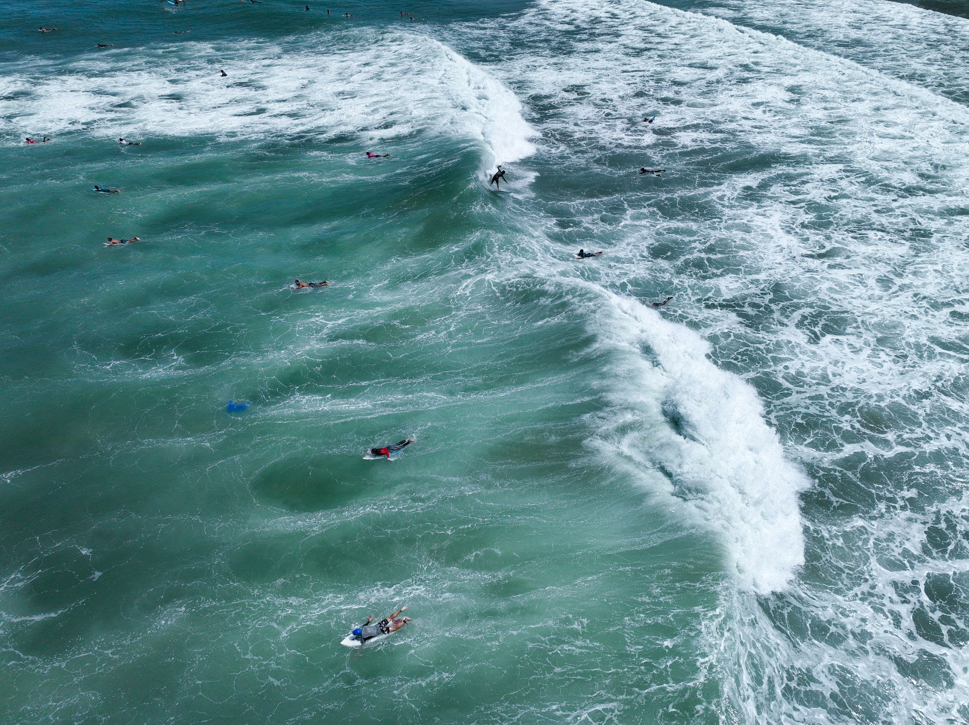
UNDERWATER Archaeology challenges
Harsh and Inaccessible Environments
Strong currents, low visibility, deep water pressures
Require specialized diving gear or submersibles
Weather and tides limit working windows
High Costs and Limited Funding
Expensive equipments
Long-running projects with limited funding
Time Constraints
Limited dive times due to safety
Conservation concerns: rapid site degradation once exposed

